Slide 1
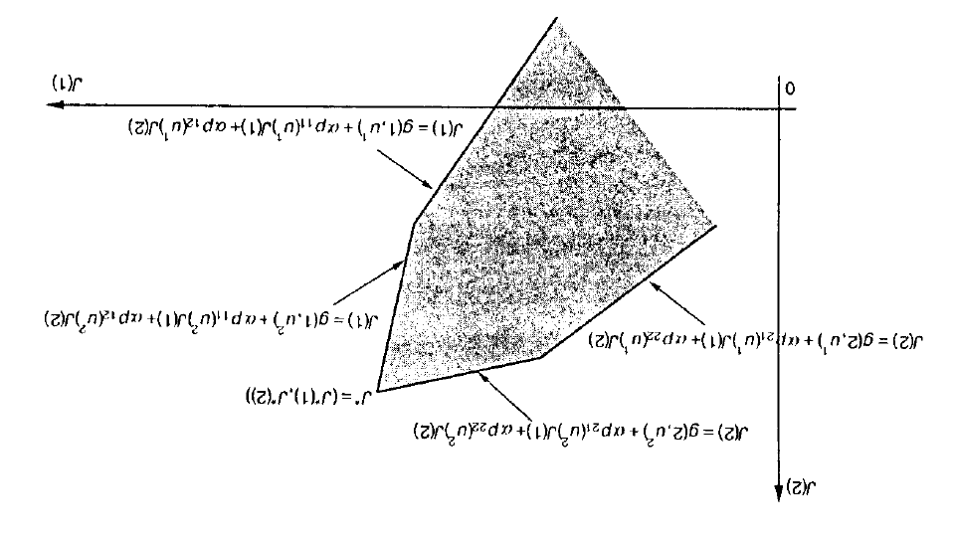

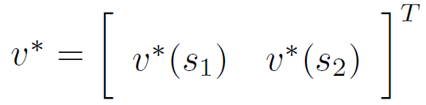


$$v(1)$$
$$v(2)$$

Slide 2



$$v(1)$$
$$v^{∗}={\left[\begin{matrix}v^{∗}(s_{1}) & v^{∗}(s_{2})\end{matrix}\right]}^{T}$$
$$v(2)$$

